Slide 1

Key Area Analysis KPI-(key performance indicator)
Filter
Food type wise
Gender wise
Age wise
Most frequently food eaten by people
No. Veg, non-veg and vegan people
No. male and female
Average price of food most frequently food eaten by people
The most frequently time that people have taken
No. Of corona affected people
Average quantity of food which is most frequently eaten by people.
The most frequently food suggested eaten by doctor
Most food delivery company was chosen by people
The most frequently food ordered by people
The range of age of people that the most frequently food eaten by people

Slide 2
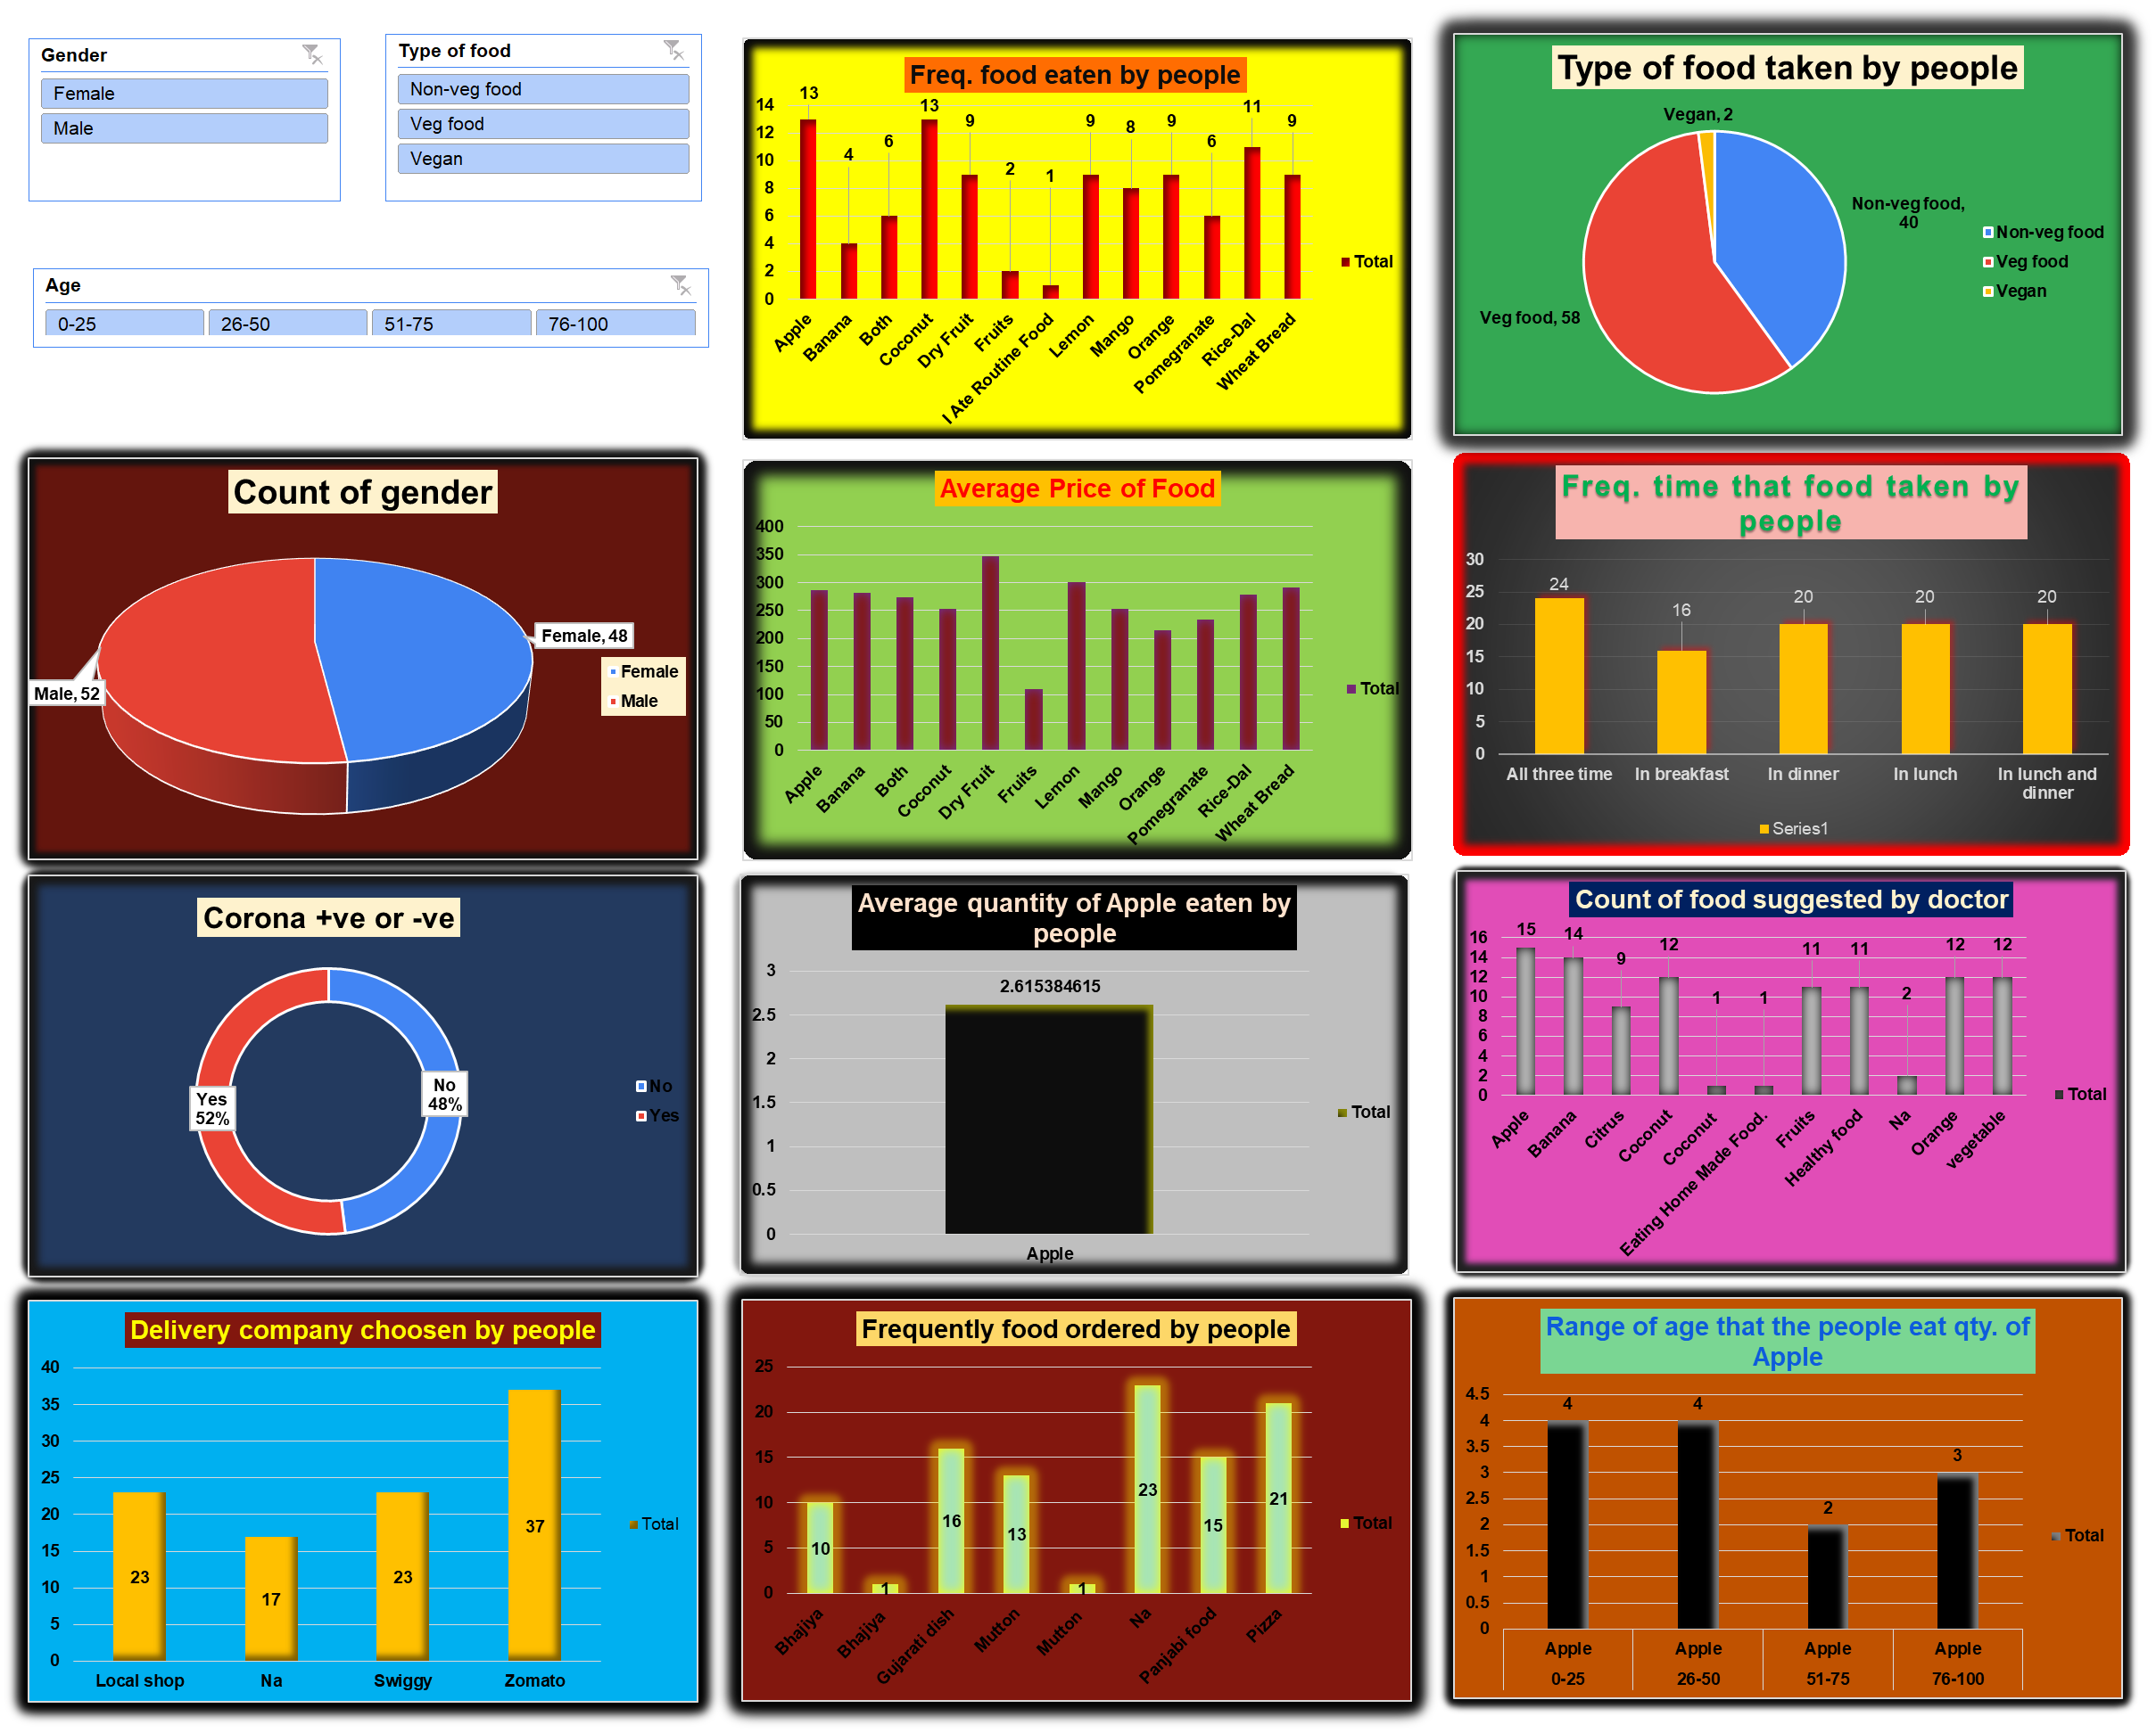
Wireframe (Skeleton Of The Report)

